Slide 1

Note: The data and information in this document is reflective of a hypothetical situation and client. This document is to be used for KPMG Virtual Internship purposes only.
Sprocket Central Pty Ltd
Data analytics approach
Created by Tram Nguyen

Slide 2
Note: The data and information in this document is reflective of a hypothetical situation and client. This document is to be used for KPMG Virtual Internship purposes only.
Agenda
Introduction
Data Exploration
Model Development
Interpretation

Slide 3
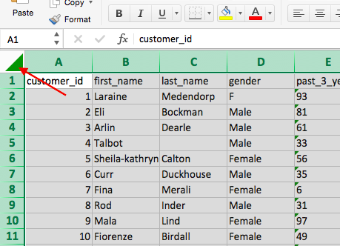
Note: The data and information in this document is reflective of a hypothetical situation and client. This document is to be used for KPMG Virtual Internship purposes only.
Introduction
Module task 1 Module task 2 Module Task 3
Task1 : identify all data quality issues.
Data incompleteness
Data inconsistency
Data Inaccuracy
Data not coming from the same source
Recommendations are attached in email to clients.
Place any supporting images, graphs, data or extra text here.

Slide 4
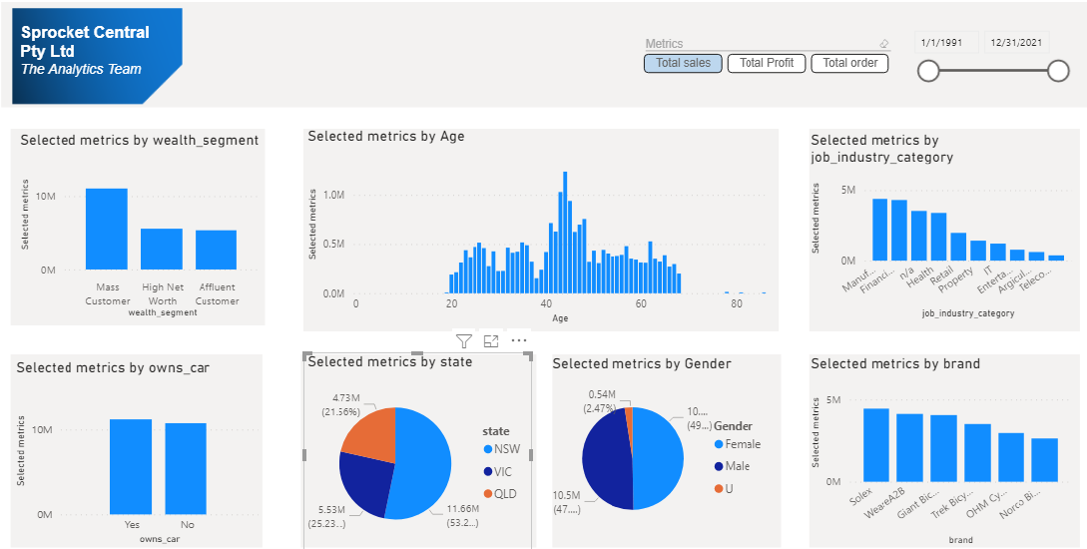
Note: The data and information in this document is reflective of a hypothetical situation and client. This document is to be used for KPMG Virtual Internship purposes only.
Data Exploration
Module task 2 : Exploration into customer demographics, geographics, psychology, and behaviour. Links
Demographics metrics:
Age: 20-70 focus group: 40-50 (highest frequency)
Wealth segment: Mass customer occupies the largest proportion of sales and profit of 10 million and 5.5 million.
Gender: almost the same distribution between male and female customers.
Job industry: Customer working in manufacturing, financial service and health sector generate the highest sales and profit (75%),
Car ownership: 50% of customer owning car.
Geographics metrics:
Most of sales derived from New South Wales (53%), Victoria(25%), Queensland(21%)
Place any supporting images, graphs, data or extra text here.

Slide 5
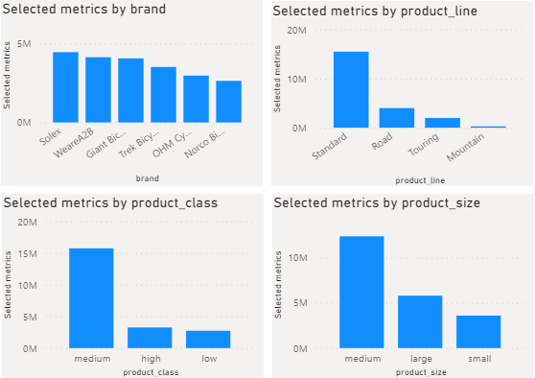
Note: The data and information in this document is reflective of a hypothetical situation and client. This document is to be used for KPMG Virtual Internship purposes only.
Data Exploration
Module task 2 : Exploration into customer demographics, geographics, psychology, and behaviour.
Psychology metrics:
Customers prefer buying products belonging to normal brands Solex, WeareA2B, Giant Bicycle. Other special purposed brands are demanded by a smaller group of customers.
Standard product line, medium product class and medium product size are the main product attributes when it comes to sales and profit.
Behaviour metrics:
There is a balance distribution between online and offline channels.

Slide 6
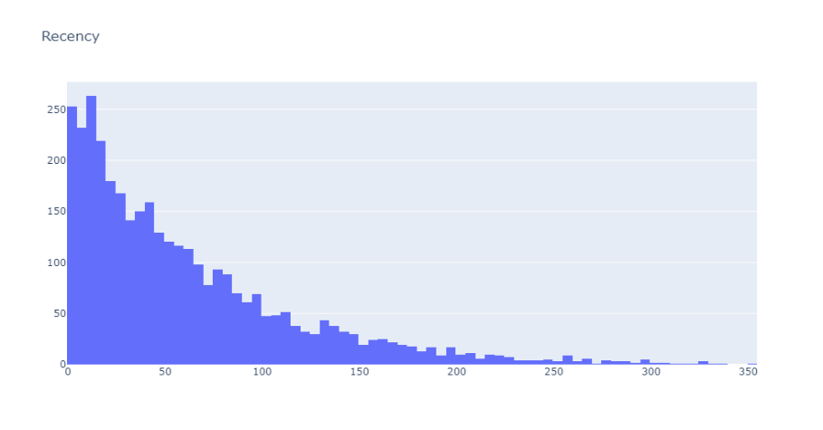
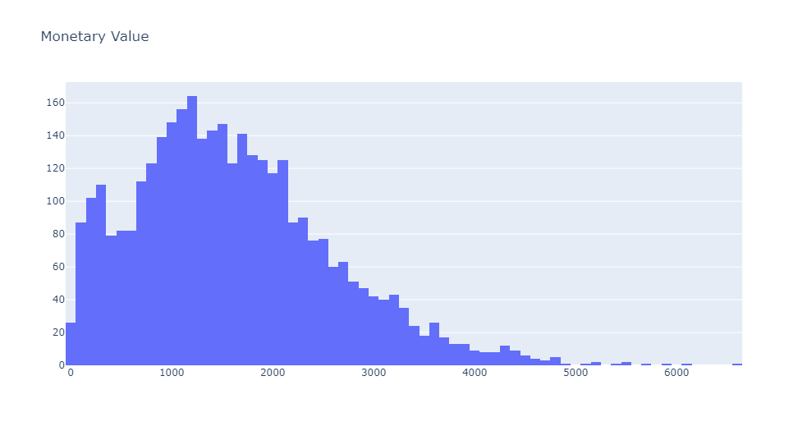
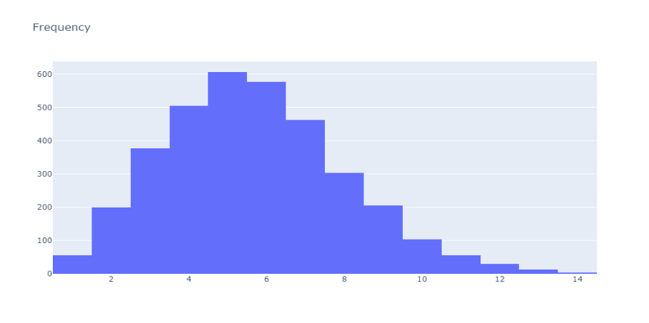
Note: The data and information in this document is reflective of a hypothetical situation and client. This document is to be used for KPMG Virtual Internship purposes only.
Model Development
Module Task 3: Business model using Recency, Frequency, Monetary Value (RFM) Links
To calculate recency, we need to find out most recent purchase date of each customer and see how many days they are inactive for.
To create frequency clusters, we need to find total number orders for each customer.
Finally, we cluster them based on revenue (monetary) for each customer.

Slide 7
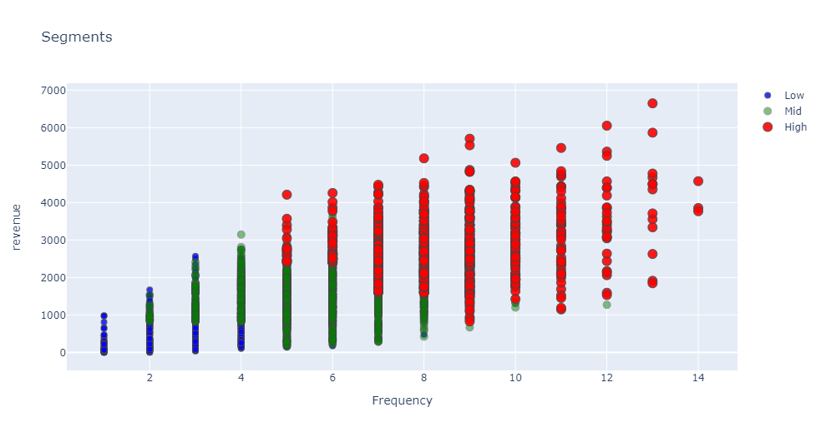
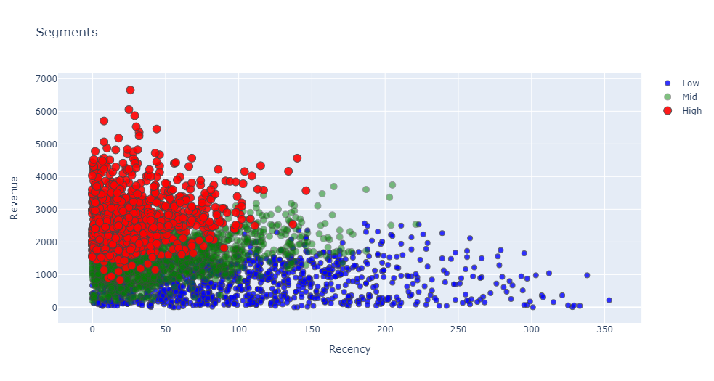
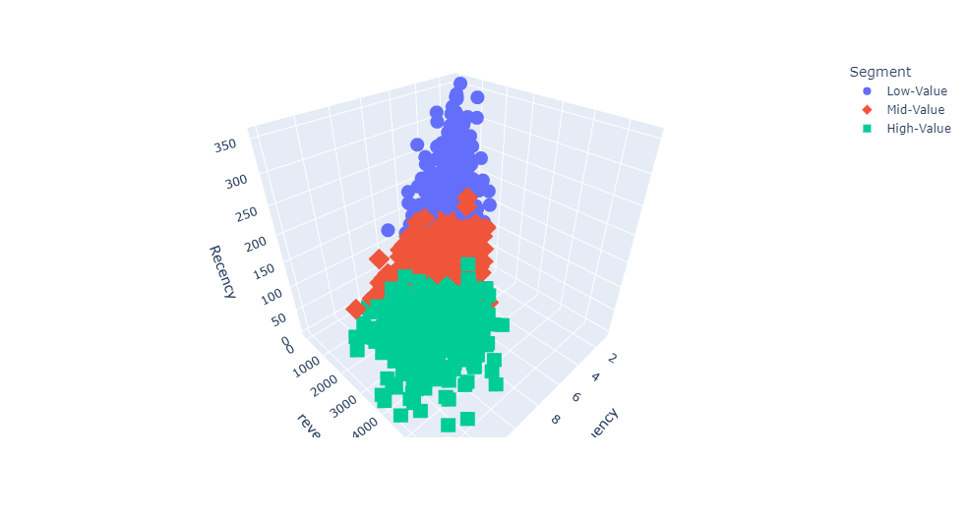
Note: The data and information in this document is reflective of a hypothetical situation and client. This document is to be used for KPMG Virtual Internship purposes only.
Model Development
Module Task 3: Overall Segmentation Links
Low Value: Customers who are less active than others, not very frequent buyer/visitor and generates very low - zero - maybe negative revenue.
Mid Value: In the middle of everything. Often using our platform (but not as much as our High Values), fairly frequent and generates moderate revenue.
High Value: The group we don’t want to lose. High Revenue, Frequency and low Inactivity.

Slide 8
Note: The data and information in this document is reflective of a hypothetical situation and client. This document is to be used for KPMG Virtual Internship purposes only.
Interpretation
Module Task 3: Overall Segmentation Links
Cluster 1: low value customers having overall score from 0-2.
Made last purchase from 100 days on earlier (more than 50 days inactive).
Total revenue per user less than $800.
Total purchase of less than 4.
Recommendation: Increase frequency.
Cluster 2: mid value customers having overall score from 3-6.
Made last purchase within 40 and 70 days ago.
Total revenue per user between $800 and $2000.
Total purchase between 4 and 6.5.
Recommendation: Improve retention + Increase Recency.
Cluster 3: high value customers having overall score from 7-10.
Made last purchase less than 40 days ago.
Total revenue per user more than $2200.
Total purchase more than 7.
Recommendation: Improve retention.

Slide 9
Note: The data and information in this document is reflective of a hypothetical situation and client. This document is to be used for KPMG Virtual Internship purposes only.
Appendix

